Slide 1
Overview of Everett Public Schools’ MTSS/PBIS Initiative

Slide 2
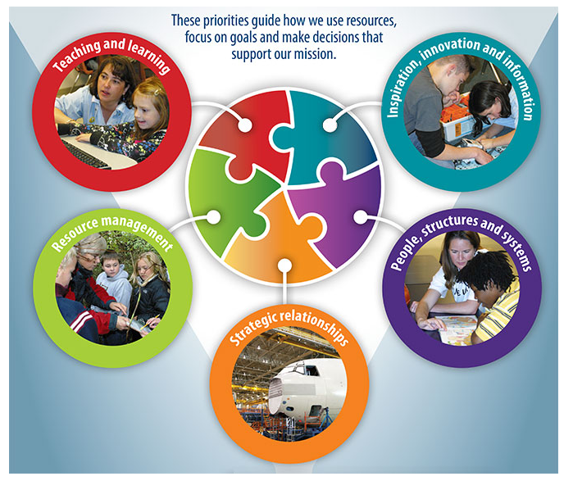
MTSS/PBIS in Everett
Goal 1 – Teaching and Learning
Each student graduates high school ready for college, career and life with 21st century skills.

Slide 3
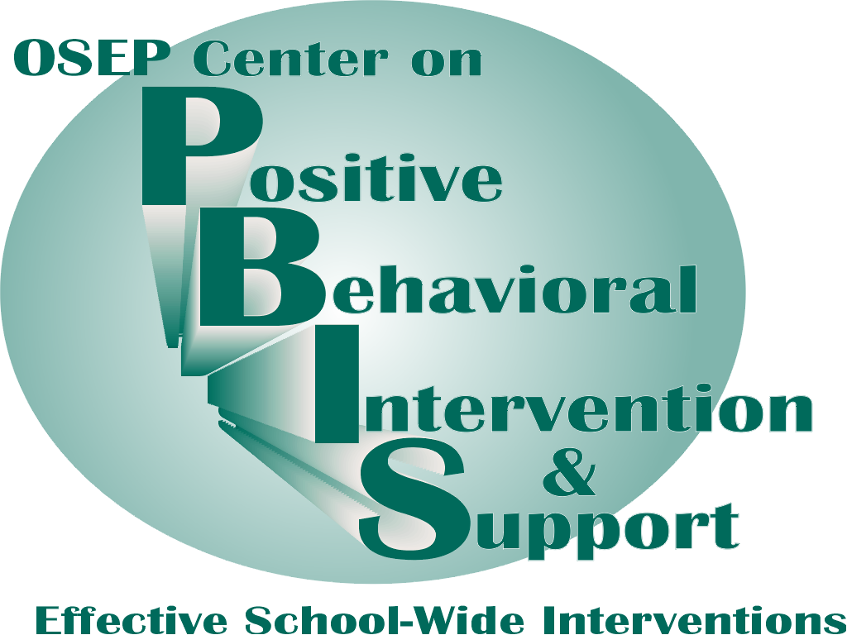
What is School-wide PBIS?
School-wide PBIS is:
  A systems approach, establishing the social culture and behavioral supports needed for schools to be effective learning environments for all students.
Evidence-based features of SW-PBIS
  Prevention
  Define and teach positive social expectations
  Acknowledge positive behavior
  Arrange consistent consequences for problem behavior
  Collection and use of data for decision-making
  Continuum of intensive, individual interventions.
  Administrative leadership – Team-based implementation

Slide 4
Why implement SWPBIS?
Create a positive school culture:
School environment is predictable
1. common language
2. common vision (understanding of expectations)
3. common experience (everyone knows)
School environment is positive
regular recognition for positive behavior
School environment is safe
violent and disruptive behavior is not tolerated
School environment is consistent
adults use similar expectations.
Notes:
Who is the kid that needs the most consistency and build your system around it—McClure Middle School example

Slide 5
PBIS Systems and Structures
SEL Curriculum and Integrated Teaching Practices that Support SEL
Notes:
Briefly review the 3 levels and concept of MTSS as integration of approaches.
Appear SEL image – universal = all kids, targeted = some/ small groups/short term,
Academic- a range of supports across needs to support academic development
Appear PBIS image- when you teach, reteach and acknowledge kids for expectations you are developing SEL. All integrates to support growth of whole child.

Slide 6
AIM: ALIGNMENT Increased Student Achievement
How Can We Best Serve ALL Students
Goals and Measures
Goals and Measures
Random Acts of Improvement
Aligned Acts of Improvement
From Jim Shipley & Associates
Notes:
6
This should all become how the school/district approaches the school improvement process.
In order to better align your school improvement acts, including the supervision and evaluation process, you must view take a holistic or systemic view of what goes on within and around your school.
The focus of these acts is always increased student achievement.
By Systems thinking, we all start pulling in the same direction toward common goals.

